Slide 1


IPL Data Analysis: Building a Winning Strategy for RCB
Aaliya Khan

Slide 2

Agenda
Problem Statement
Data Description
Setting the Context (The Unanswered Question: Why No Trophy? & RCB Performance Overview (Season-wise))
On-Field Patterns & Tactical Insights (Home vs Away Performance & Toss Decisions & Venue Impact)
Team Dependency & Squad Structure(Player Presence & Morale Impact, Squad Balance: Batting vs Bowling, Role of All-Rounders & Stars vs Team Performance)
The Verdict & The Way Forward (Key Reasons for the Trophy Drought & Forging a New Path: Strategies for Success)

Slide 3
Problem Statement
You are hired as a sport data analyst by RCB where the team is looking for top-performing and reliable players to win tournaments, considering both on-field performance and value for money in mega player auction of 2017.
Your task is to come up with strategies/suggestions regarding selecting the best-performing players and optimizing player auction investments.

Slide 4
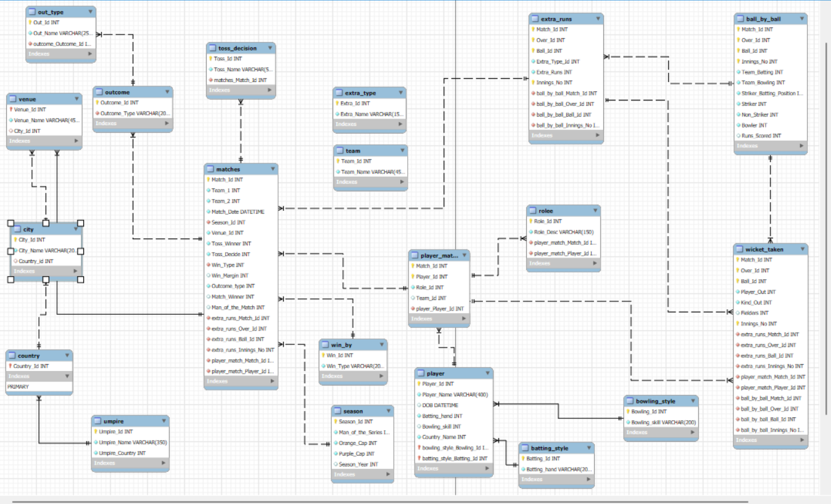
Database schema

Slide 5
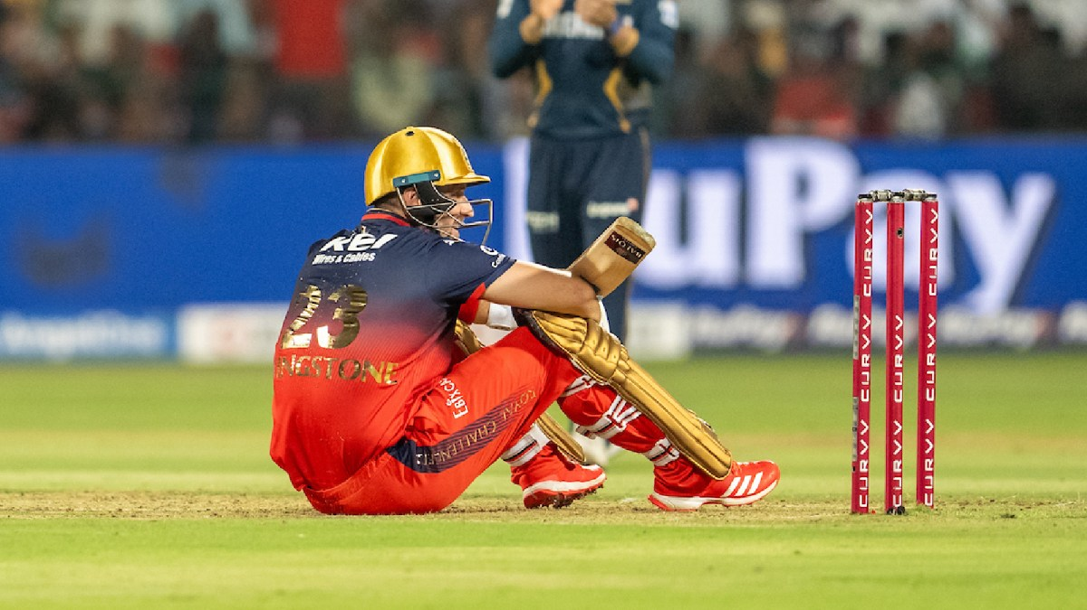
The Unanswered Question:
Why No Trophy?
Despite boasting world-class talent across multiple seasons, the Royal Challengers Bangalore have yet to lift the IPL trophy. This analysis dives deep into performance patterns, identifies critical gaps, and proposes data-driven strategies for future success.

Slide 6
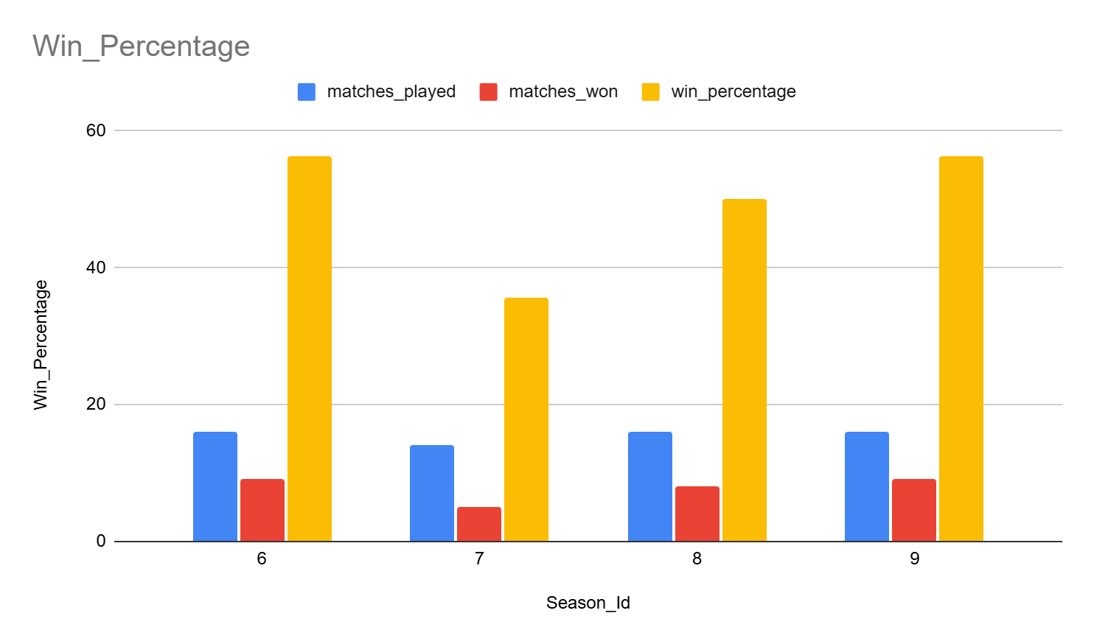
RCB Performance Overview (Season-wise)
RCB has shown high volatility in performance across seasons
Strong individual seasons did not translate into sustained success
Indicates inconsistency rather than lack of talent

Slide 7
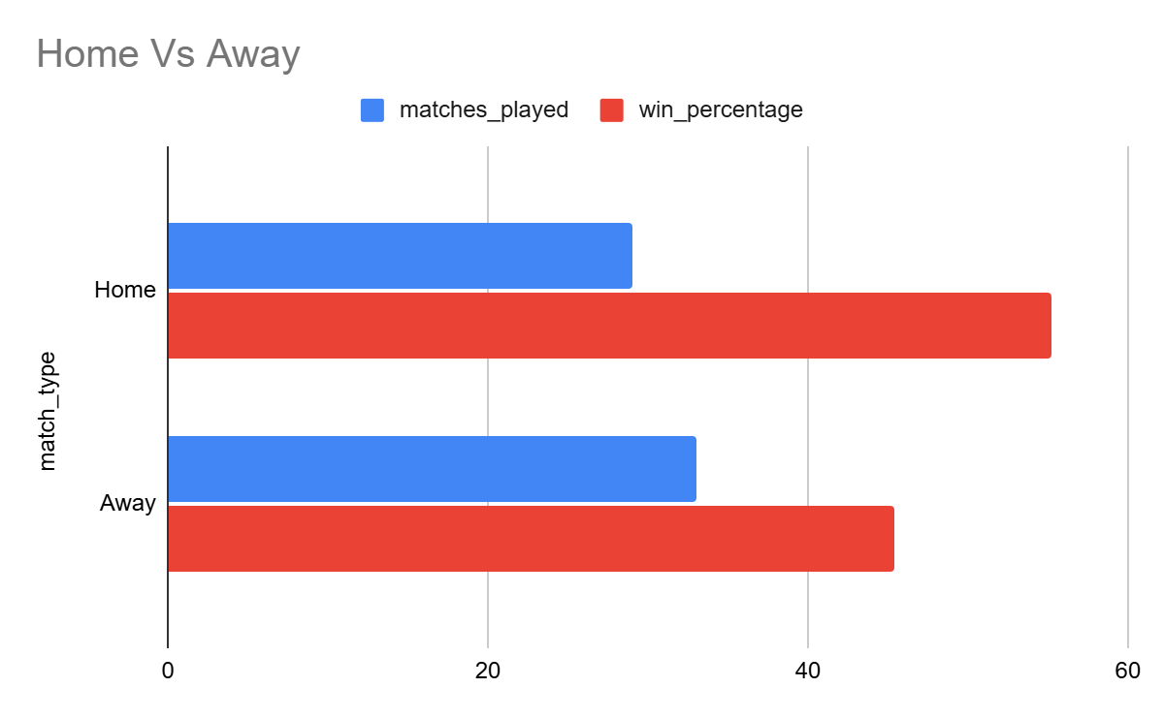
Home vs Away performance
RCB performs significantly better at home than in away conditions.
Away matches expose adaptability issues to pitch and venue variations.
Over-reliance on home advantage limits overall tournament success.

Slide 8
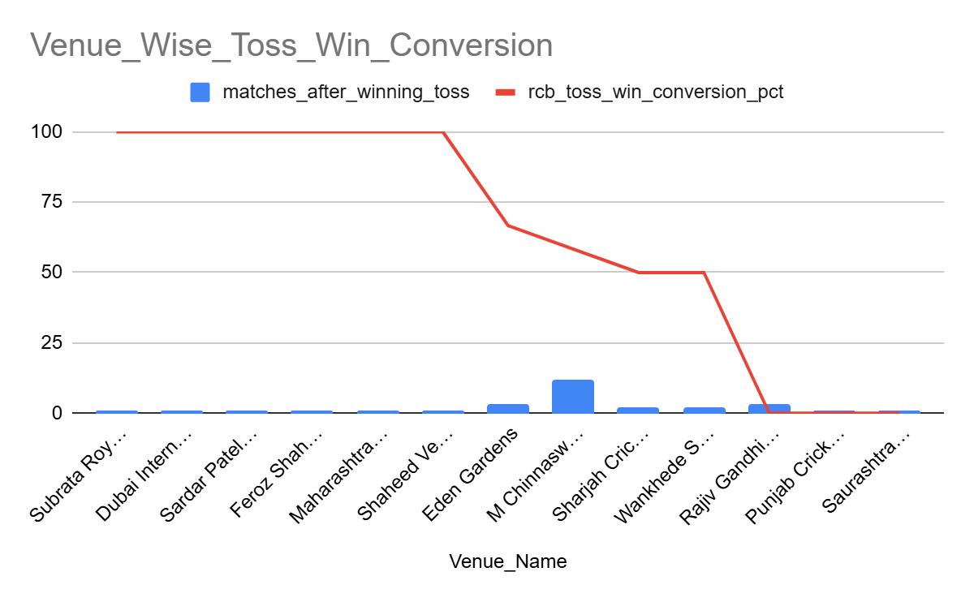
Toss Decisions & Venue Impact
Toss decisions worked only at select venues, not universally.
Same decisions led to opposite outcomes across venues, showing rigid strategy.
Suggests poor alignment between toss choice and pitch behavior.

Slide 9
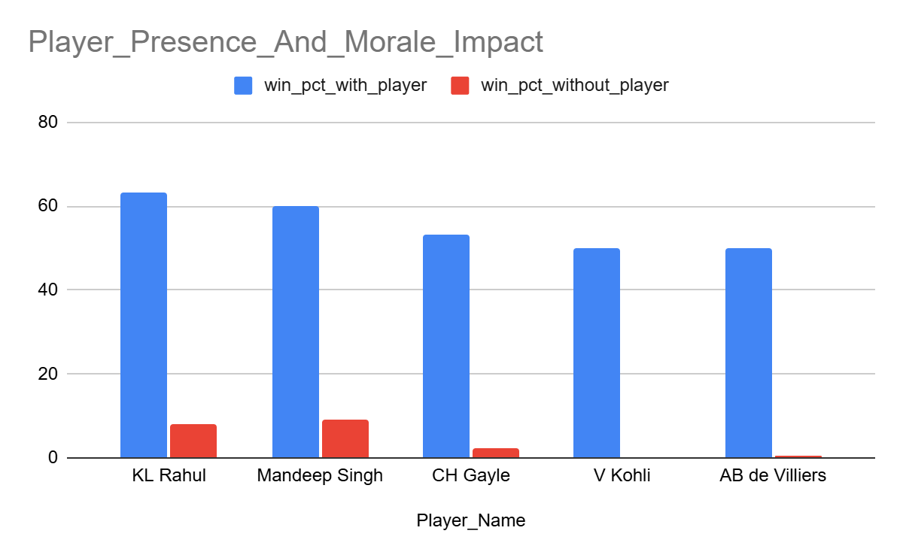
Player Presence & Morale Impact
Certain players show a sharp increase in team win percentage when present.
Team performance drops noticeably in their absence.
Highlights over-dependence on a few individuals rather than a strong unit.

Slide 10
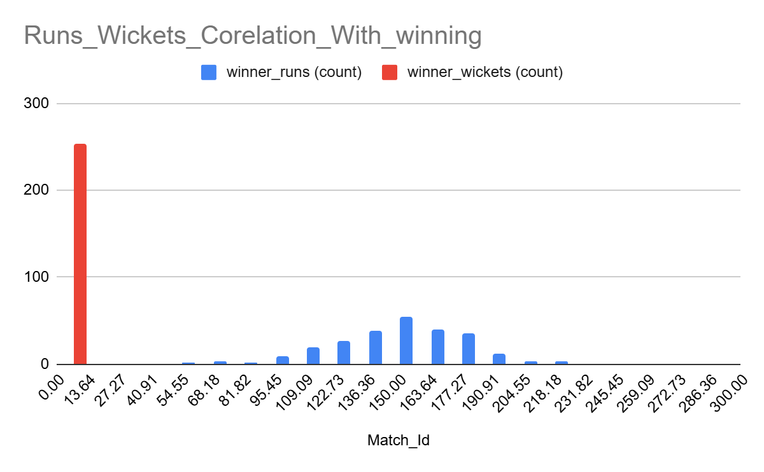
Squad Balance – Batting vs Bowling
Batting performances often outshine bowling contributions.
Bowling unit lacks consistent wicket-taking across seasons.
Imbalance leads to inability to defend totals or control chases.

Slide 11
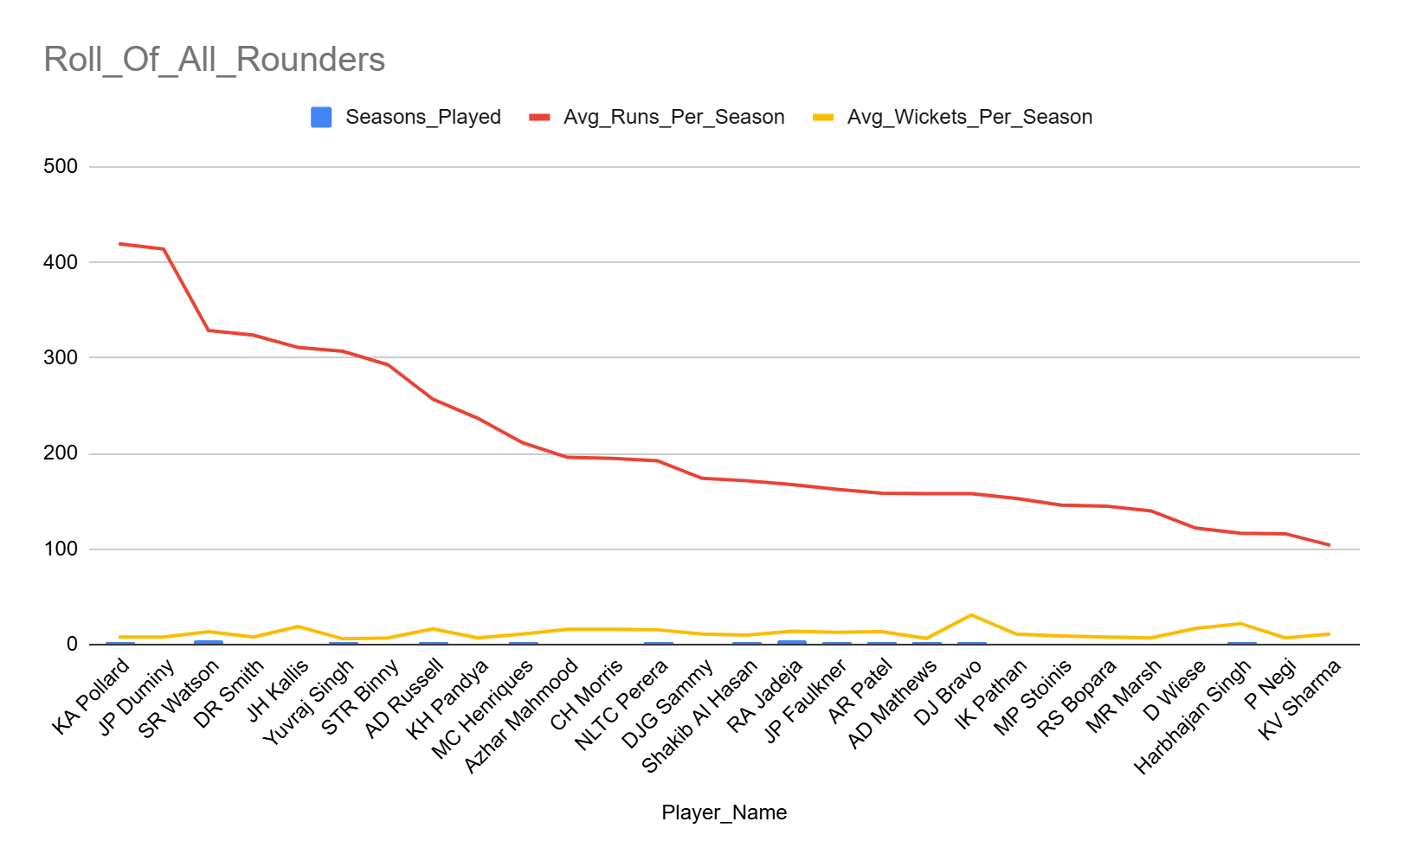
Role of All-Rounders
Successful teams show stronger contribution from multi-skill players.
RCB’s all-rounder impact has been limited and inconsistent.
Lack of depth puts pressure on top-order batters and strike bowlers.

Slide 12
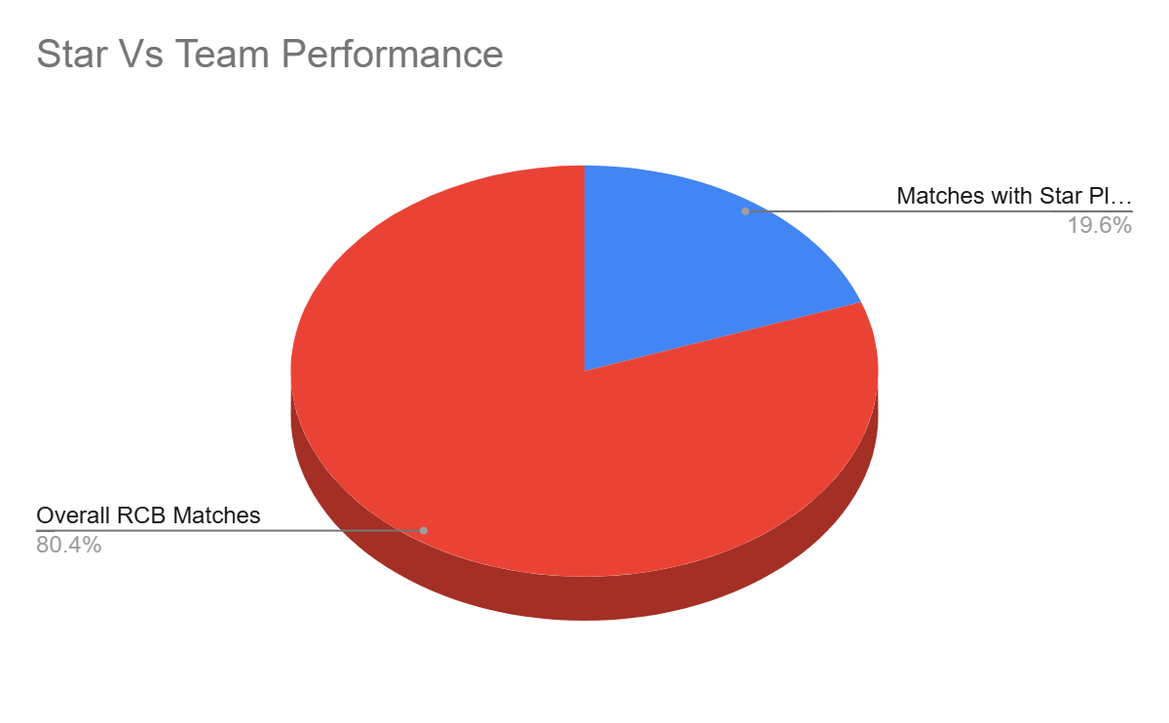
Stars vs Team Performance
Presence of star players boosts individual match outcomes.
However, stars alone could not ensure playoff consistency or finals dominance.
Trophies require collective performance, not isolated brilliance.

Slide 13

Why NO Trophy:
Season-wise inconsistency: Strong individual seasons were followed by sharp performance drop-offs, preventing sustained title momentum.
Tactical rigidity: Similar toss and match strategies were applied across different venues, ignoring pitch and condition variability.
Over-reliance on Star Players: The team's fate often hinged on a handful of top performers.
Inconsistent Bowling Unit: A lack of sustained quality and depth, particularly in death bowling.
Lack of All-Round Depth: Insufficient genuine multi-faceted players to provide balance.
Away Conditions Adaptation: Difficulty in performing consistently outside home ground advantage.
Squad Building Strategy: Focus on individual stars over a balanced team composition.

Slide 14
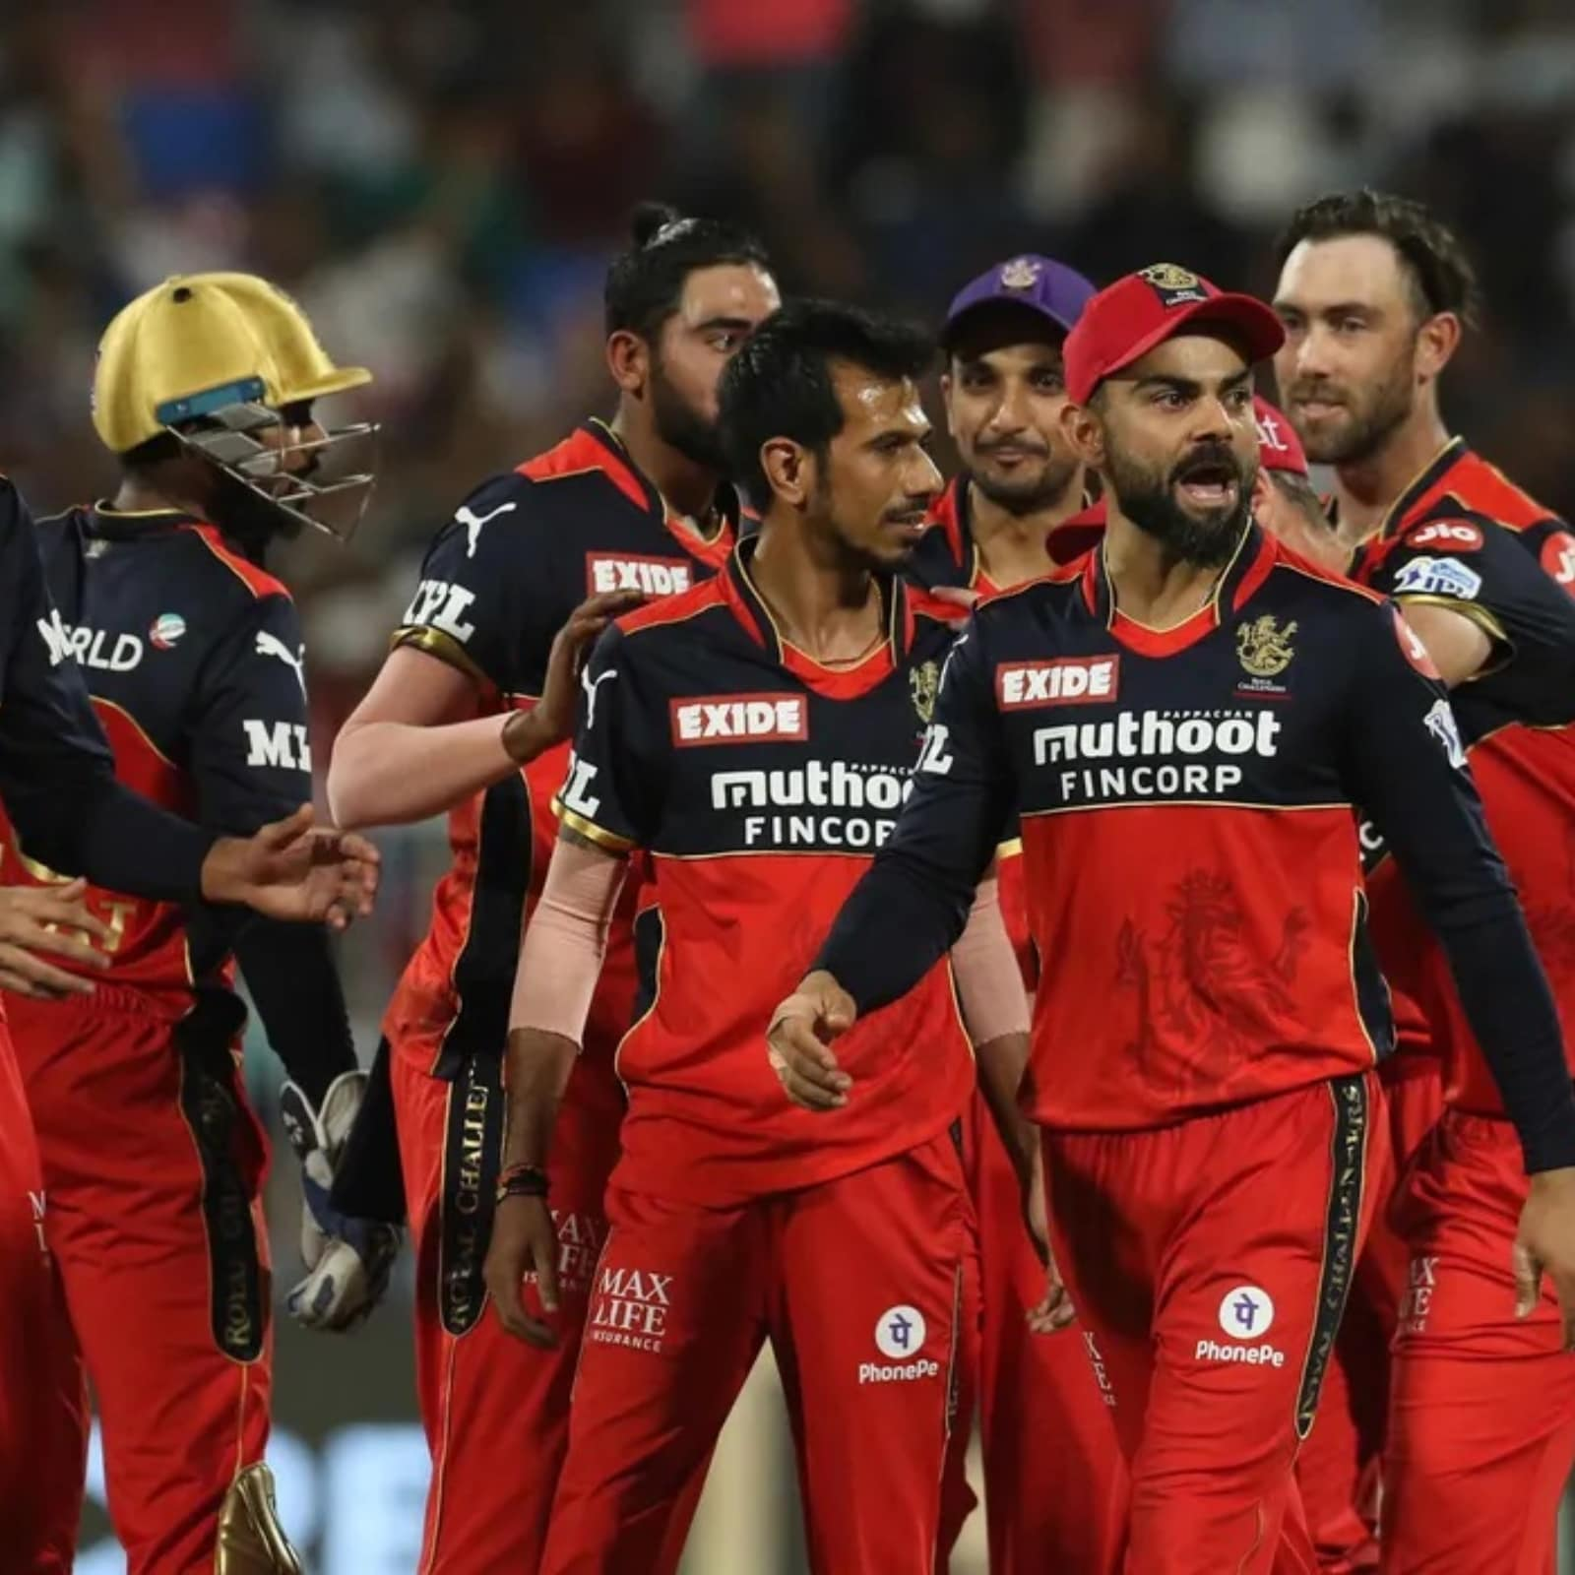
Forging a New Path: Strategies for Success
What Went Wrong:-
Inconsistent performances across seasons.
One-dimensional match strategies.
Over-reliance on individual match-winners.
What Must Be Implemented:
Role-based squad construction.
Venue-aware and situation-based tactics.
Reduced dependency on a few stars through stronger team balance.
RCB has always had match-winners.
What it now needs is a match-winning system.

Slide 15
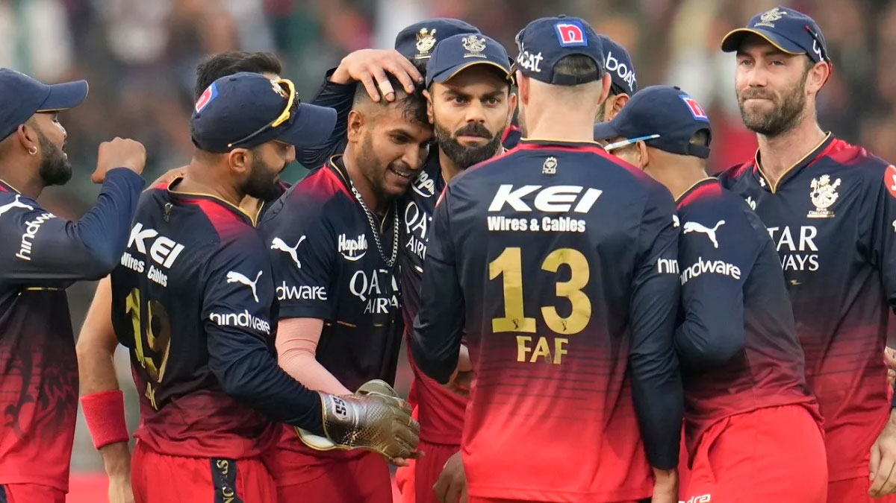
Recommendations:
Invest in genuine all-rounders
All-rounder analysis shows players contributing with both bat and ball create balance and reduce pressure on top-order batters and strike bowlers.
Strengthen bowling for high-scoring venues
High average first-innings scores and powerplay/death-over data indicate RCB must prioritize wicket-taking bowlers, not just economy bowlers.
Build backups for key roles
Morale-impact analysis highlights performance drops without certain players. Every critical role must have a reliable backup to avoid collapse during injuries or form slumps.

Slide 16

Conclusion:
Despite producing some of the league’s greatest individual performances, RCB’s data tells a consistent story — success came in flashes, not as a sustained force. Strong home performances, star-driven wins, and occasional peak seasons were undone by inconsistency, tactical inflexibility, and over-dependence on a few players. To finally lift the trophy, RCB must transition from a star-powered team to a strategically balanced unit, using data-driven decisions for auctions, venue planning, and squad rotation. Championships are not won by moments of brilliance, but by consistency, depth, and adaptability.

Slide 17
Thank You

